Slide 1
TUGS: Class Notations and Guidance
Athens, 07 December 2022
Christoforos Georgakopoulos
Senior Specialist
Hull Structures

Slide 2
Contents
1. Background
2. Classification
3. Statutory

Slide 3
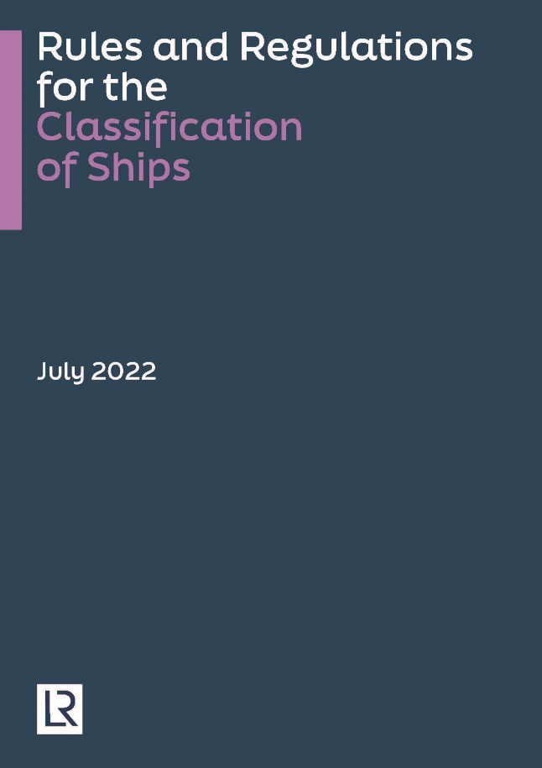
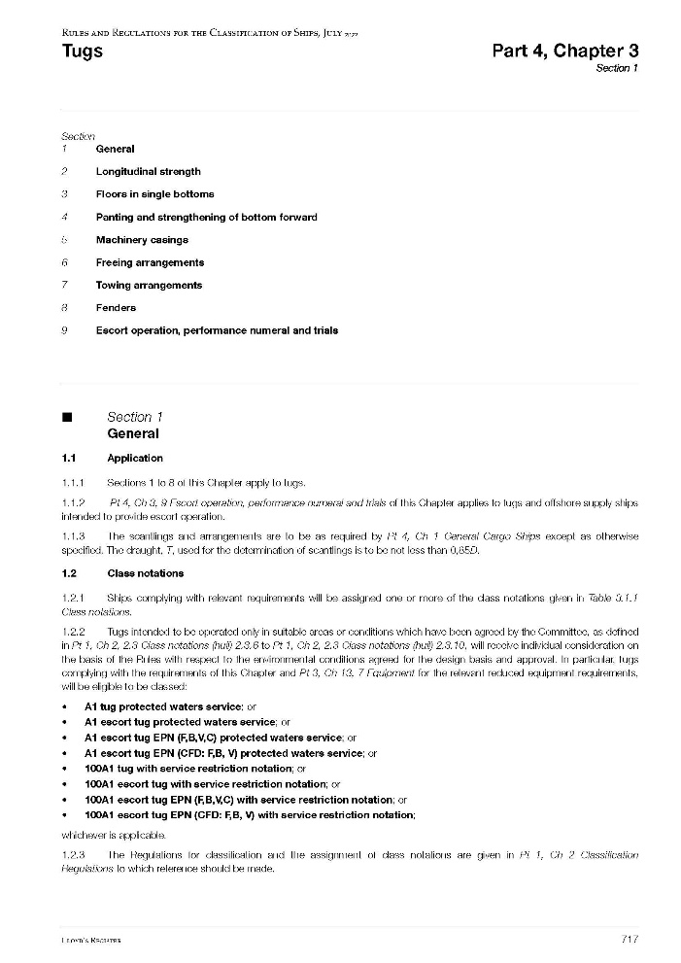
1. Background > Scope
Classification requires that vessel complies with the Rules and Regulations of Lloyd’s Register.
For all tugs, LR requirements include:
Pt 1, Ch 2, 2 Class Notations
Pt 1, Ch 2, 3 Surveys - General
Pt 3, Ch 1, 7 Equipment Number
Pt 3, Ch 8, 5.5 Special Requirements
Pt 3, Ch 13, 7 Equipment
Pt 4, Ch 3 Tugs
Pt 4, Ch 4 Offshore Support
Statutory Requirements set by Flag are also to be complied.

Slide 4
1. Background > Operation Profiles
Typical operational profiles for which a tug might be designed and equipped:
Harbour tugs
Equipped to assist vessels while entering/leaving port or berthing/unberthing
Considered to operate in calm areas (sheltered waters)
Usually work from a fixed port (crew familiar with operating area, in case of emergency shore assistance directly available)
Seagoing tugs
Equipped to assist vessels at sea, common categories:
- Coastal tugs: Short distance from shore (<4hrs from sheltered area)
- Offshore terminal tugs: Specified location
- Deep sea tugs: No restriction, can operate in any seaway (shore assistance not available)
- Salvage tugs: Considered as Seagoing tugs that should be able to operate under all conditions
Escort tugs
Equipped to escort ships during navigation in open sea and/or sheltered waters
Any limitation in service area to be indicated in LR notation

Slide 5
1. Background > Typical Design Arrangements
Typical tug design arrangements :
Conventional tugs
Single or multiple shaftline. Propeller(s) can be of fixed pitch or controllable.
Normally fitted with Kort nozzle. Steering by means of rudder(s) or steerable nozzle(s).
Tractor tugs
Omnidirectional thrusters (typically two steerable propellers or Voith–Schneider type cycloidal propeller).
A skeg or vertical fin is fitted aft.
Azimuth Stern Drive tugs
Fitted with azimuth thrusters in nozzles aft.
Typically can perform towing operations over the bow and over the stern.
Other tug design arrangements can be specially considered by LR on a case-by-case basis.

Slide 6
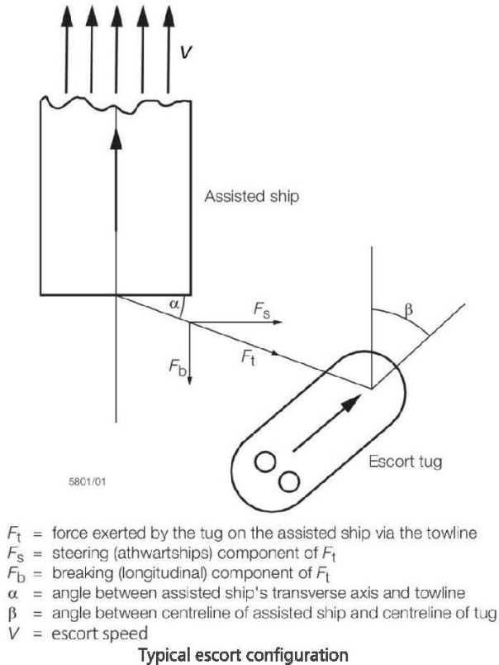
1. Background > Definitions (1/3)
Bollard Pull:
- Maximum sustained towline force at zero speed
- Specified by designer and can be verified by full scale test
Tug Force / Escort Speed:
- Steady towline force during escorting for a given speed
- Specified by designer and can be verified by full scale test,
model test or simulation
Reference Towline Force:
- For notation Tug equal to the Bollard Pull
- For notation Escort Tug equal to the Maximum Steady Towline force

Slide 7
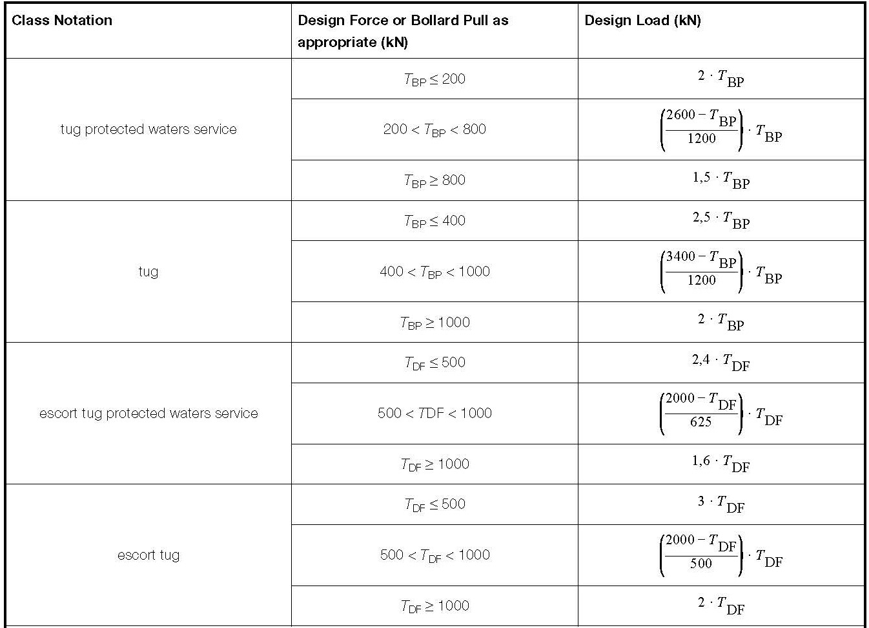
1. Background > Definitions (2/3)
Design Load DL = T x DAF:
- This force is a critical factor used for the strength analysis of the towing equipment and its supporting structures

Slide 8
1. Background > Definitions 3/3
Winch Brake Holding Load BHL:
- BHL is the maximum force the towing winch can withstand without slipping of the brake.
- Reference for the strength assessment and testing of towing winches and associated towing fittings (e.g. fairlead, staple, gob-eye) as well as their supporting structures.
Towline Breaking Strength:
- The tension required to cause failure of the towline (parting of the towline).

Slide 9
2. Classification > Type Notations
As with all vessels entering Class, the governing requirements for the tugs are defined as a function of the selected service notation.
LR offers the following Type Notations:
Tug
Escort tug
Offshore tug
AHTS (Anchor Handler Tug Supply)
Notes:
Harbour tugs are Classed in LR as Tug with service restriction notation ‘’protected waters’’.
Offshore tug and AHTS need also comply with certain parts of the LR Rules for Offshore Support

Slide 10
2. Classification > Service Restriction Notations
In the case of some tugs e.g. Harbour tugs, designing to unrestricted seagoing service may be too onerous, therefore a ‘Service Restriction Notation’ can be used to reflect a more appropriate operational profile of the vessel.
Notes:
Other service notations may be agreed with the Class Committee.
Service Restriction Notation | Typical Text | Explanation
Protected waters service | Protected waters service | Non exposed, sheltered waters
Extended protected waters service | Extended protected waters service | Short distance from protected waters
Specified route service | ‘’name of Port to name of Port’’ | Service between two or more ports
Specified coastal service | ‘’name of Country’’ Coastal Service | Within specified coastal waters
Specified operating area service | For service within “X” nm “name of geographical point” Or For service within “defined geographical area” | Within a specified area

Slide 11
2. Classification > Special features
Additional Notations may include:
Notation ‘’Oil Recovery or Oil Recovery (F.P.>60ºC)’’
Vessels equipped handle, store and transport oil recovered from a spill
– Pt 7, Ch 5 (construction, machinery, electrical, fire extinguishing and protection)
Notation ‘’Fire-fighting ship 1 or 2 or 3 (with water spray)’’
Vessels for fire-fighting operations
– Pt 7, Ch 3 (construction, fire extinguishing and protection, lighting)
Notation ‘’Standby vessel’’
Vessels providing rescue assistance and safe refuge in an emergency
– Pt 4, Ch 4, 1-8 (general, construction, machinery, fire extinguishing and protection)

Slide 12
2. Classification > Notation example
Class Notation | Applicable Sections
+ 100A1 tug + LMC | Seagoing Tug, unrestricted, no special feature
+ A1 tug protected waters service | Tug, protected waters
+ 100A1 tug Fire-fighting Ship 1 + LMC UMS | Seagoing Tug, Unmanned Engine Room, FiFi capabilities Class 1
+ 100A1 escort tug + LMC UMS | Escort Tug, Unmanned Engine Room
+ 100A1 escort tug EPN (F, B, V, C) Fire-fighting Ship 1 + LMC UMS | Escort Tug, (with performance numeral), Unmanned Engine Room, FiFi capabilities Class 1, Escort performance verified with full-scale trials
+ 100A1 escort tug EPN (CFD: F, B, V) Fire-fighting Ship 1 with water spray + LMC UMS | Escort Tug, Unmanned Engine Room, FiFi capabilities Class 1 with water spray Escort performance determined with CFD prediction

Slide 13
2. Classification > Rules and Requirements
SAFETUG I & SAFETUG II JIPs (oil companies, tug operators, Classes, Yards, Makers etc.)
Output of SAFETUG led to revised LR Part 4 Chapter 3 ‘’Rules for Tugs’’ in 2017
– New concept of design load and strength assessment of the towing equipment
– New allowable stresses
– New requirements for strength of tow line guiding fittings (fairlead, god-eyes, staples etc.)
IACS UR M79 let to a LR new Part 7 Chapter 16 ‘’ Winch Em’cy release systems’’ in 2019

Slide 14

3. Statutory > General
LR Guidance for Statutory aspects
In all cases the Flag Administration statutory requirements are to be met
In cases where there is a conflict between the Guidance and the Flag Administration requirements or where LR is not authorised by a particular Flag Administration, the requirements and guidance of the Flag Administration take precedent over any statutory guidance presented in this document

Slide 15
3. Statutory
> Stability
L_{L} > 24 m Adequate Intact Stability demonstrated (Compliance with Flag requirements)
Reference LR guidance also in line with:
2016 Amendments MSC.415(97)
IS 2008 Code 2020
> Fire Safery, LSA, Radio, Navigation
GT < 500 less than SOLAS size (300 GT for Radio)
IACS Rec.99
LR Guidance requirements

Slide 16
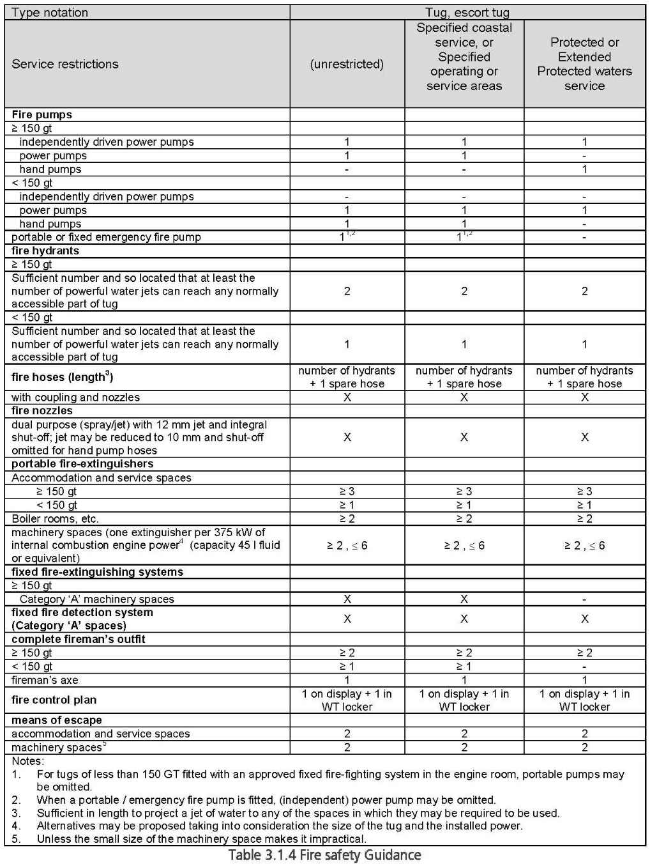
3. Statutory > Fire safety guidance

Slide 17
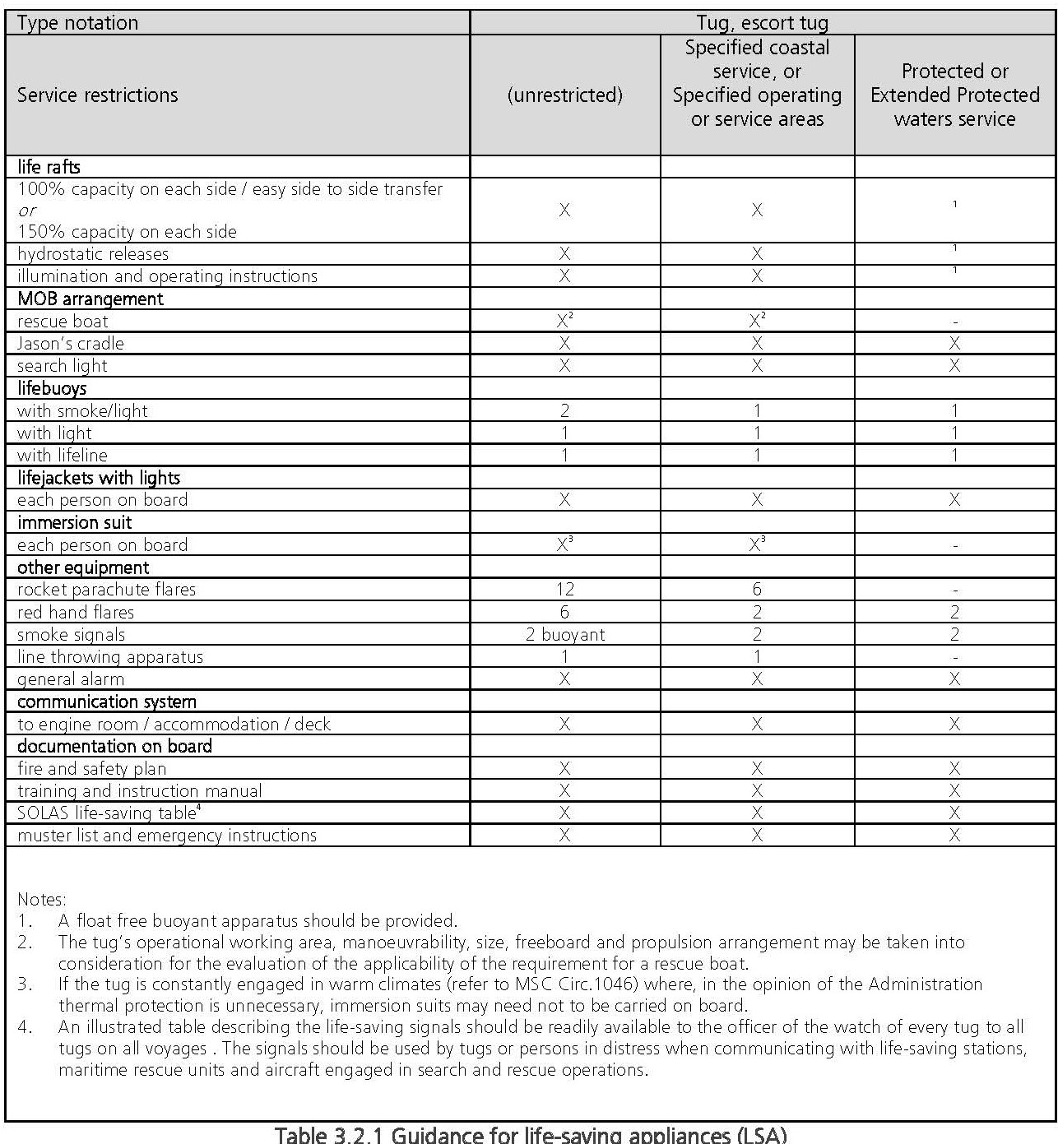
3. Statutory > LSA guidance

Slide 18
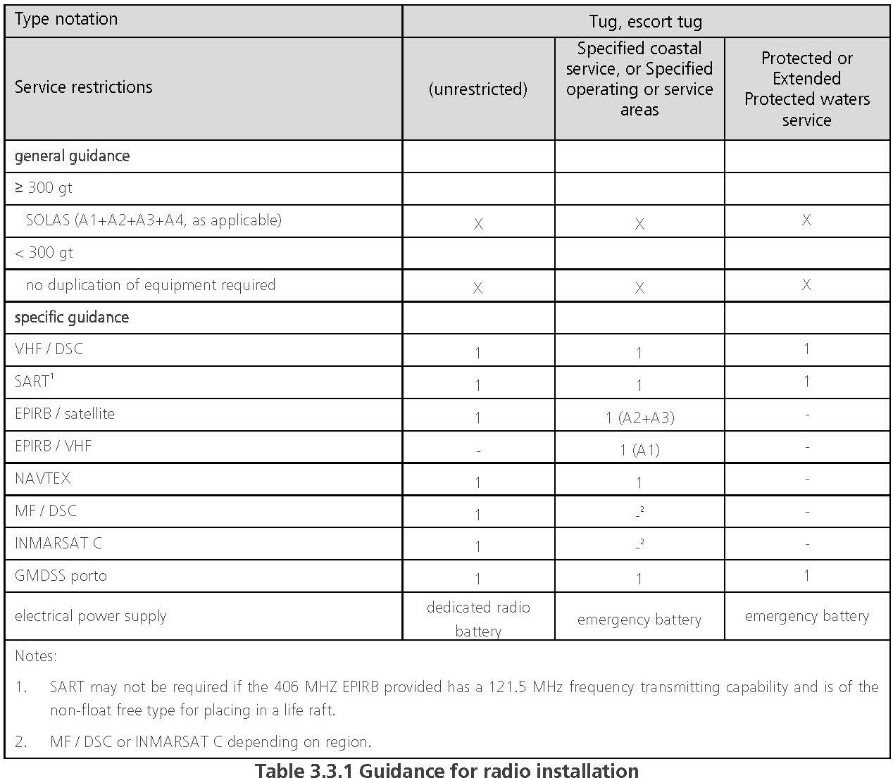
3. Statutory > Radio guidance

Slide 19
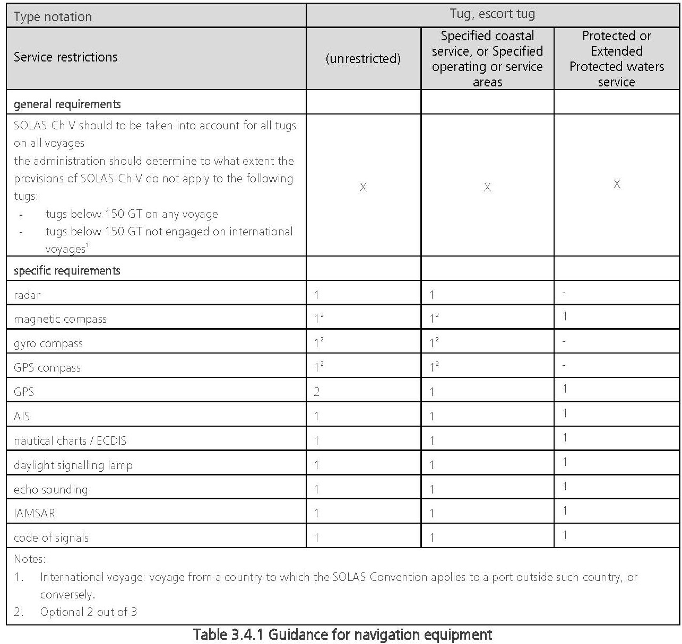
3. Statutory > Navigation equipment guidance

Slide 20
Thank you
Christoforos Georgakopoulos
Senior Specialist
Hull Structures
E christoforos.georgakopoulos@lr.org
T +30 211 9907795
M +30 6951830212
Hellenic Lloyd’s S.A.
Piraeus Technical Support Office

